Slide 1

INTRO TO dEEP LEARNING & NEURAL NETWORKS

Slide 2
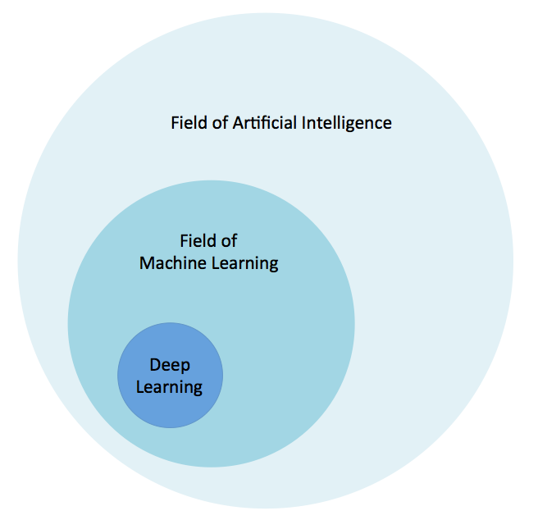
What is Deep Learning ?
To understand what deep learning is, we first need to understand the relationship deep learning has with machine learning, neural networks, and artificial intelligence.
The best way to think of this relationship is to visualize them as concentric circles:
At the outer most ring you have artificial intelligence (using computers to reason). One layer inside of that is machine learning. With artificial neural networks and deep learning at the center.
Broadly speaking, deep learning is a more approachable name for an artificial neural network. The “deep” in deep learning refers to the depth of the network. An artificial neural network can be very shallow.

Slide 3
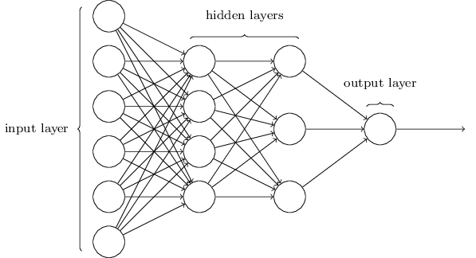
Neural networks are inspired by the structure of the cerebral cortex. At the basic level is the perceptron, the mathematical representation of a biological neuron. Like in the cerebral cortex, there can be several layers of interconnected perceptron.
The first layer is the input layer. Each node in this layer takes an input, and then passes its output as the input to each node in the next layer. There are generally no connections between nodes in the same layer and the last layer produces the outputs.
We call the middle part the hidden layer. These neurons have no connection to the outside (e.g. input or output) and are only activated by nodes in the previous layer.
Think of deep learning as the technique for learning in neural networks that utilizes multiple layers of abstraction to solve pattern recognition problems. In the 1980s, most neural networks were a single layer due to the cost of computation and availability of data.

Slide 4
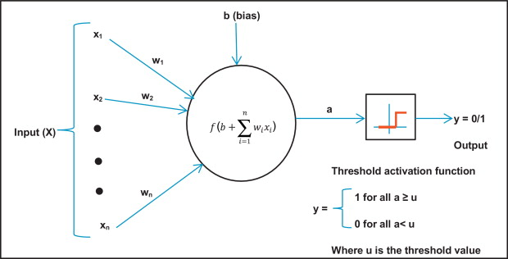
PERCEPTRON
The perceptron is the oldest neural network, created by Frank Rosenblatt in 1958. It has a single neuron and is the simplest form of a neural network: A Perceptron is a neural network unit that does certain computations to detect features or business intelligence in the input data.
It is a function that maps its input “x,” which is multiplied by the learned weight coefficient, and generates an output value ”f(x).

Slide 5
TERMINOLOGIES
Input layer represents dimensions of the input vector.
Hidden layer represents the intermediary nodes that divide the input space into regions with (soft) boundaries. It takes in a set of weighted inputs and produces output through an activation function.
Output layer represents the output of the neural network.
Weights are numeric values that are multiplied by inputs. In simple words, weights are machine-learned values from Neural Networks. They self-adjust depending on the difference between predicted outputs vs training inputs.
Activation Function is a mathematical formula that helps the neuron to switch ON/OFF.

Slide 6
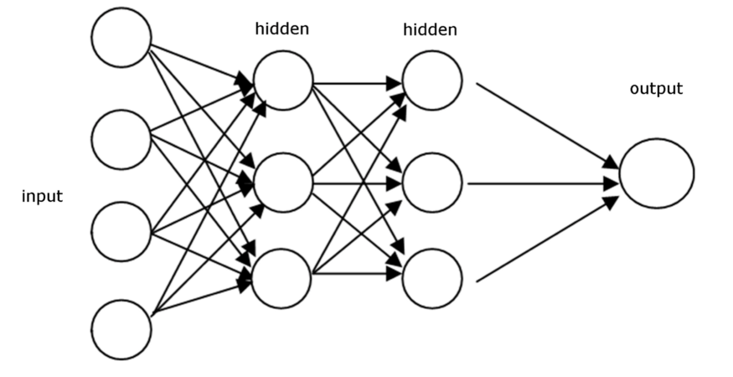
Forward Propagation
In terms of Neural Network, forward propagation is important and it will help to decide whether assigned weights are good to learn for the given problem statement. There are two major steps performed in forward propagation technically:
Sum the product It means multiplying weight vector with the given input vector. And, then it keeps going on till the final layer where we make the decision.
Pass the sum through activation function Sum of product of weight and input vector is passed in every layer to give you the output layer. And, then output of 1 layer becomes input of next layer to be multiplied with weight vector in that layer. And, this process goes on till the output layer activation function.

Slide 7
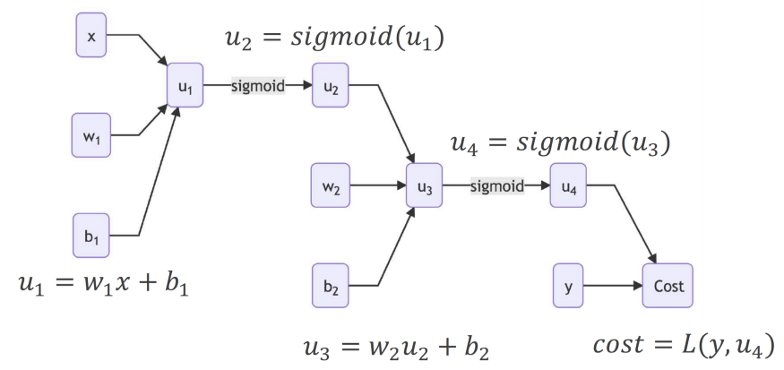
In this given network, feedforward is easy to understand. x is initial input, b1 is bias and w1 is weight. Every layer has sigmoid as activation function. Predicted value is u4 and cost is error / loss calculated. Sum of production is u1, u3. u2 and u4 are output after applying activation function i.e., sigmoid in this case. I hope this will help to understand feedforward network till the loss calculation.

Slide 8
Backward Propagation
In machine learning, backward propagation is one of the important algorithms for training the feed forward network. Once we have passed through forward network, we get predicted output to compare with target output. Based on this, we understood that we can calculated the total loss and say whether model is good to go or not. If not, we make use of loss value to recalculate weights again for forward pass. And, these weight re-calculation process is made simple and efficient using back-propagation.
Back-propagation computes the gradient of the loss function with respect to the weights of the network
Compute the Errors Difference between expected output and predicted output received in forward pass. This process will keep giving the Error / Loss in every single forward pass. If loss/error is acceptable, you can store the model to test with test data.
Get the delta Multiply the error with the derivative to get the delta
Sum the product Multiply the delta with the input vector and so on to get the sum of the product.
Terms to understand for forward & back propagation: dot product, derivative, chain rule, gradient, loss / error calculation & its method.

Slide 9
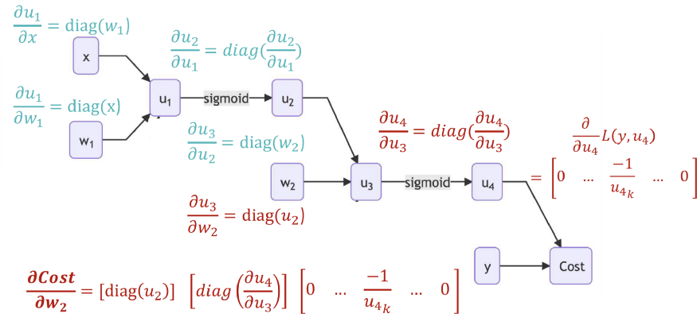
After the forward pass and cost calculation (error/loss), Backpropagation takes place to get the delta. For calculating delta, it applies partial derivative and it starts from output to the last layer. And, once delta is calculated for the last layer, below formula is applied to get the new weight.
new weight = old weight - delta * learning rate
Here learning rate can be any assumed value between 0 and 1. Once new weight is calculated for the last layer, this process moves on to the previous hidden layer to calculate delta and new weight. This makes use of chain rule to get the delta for the hidden layer as we can see the image attached below. Formula in red is showing the direct formula via chain rule and partial derivative.

Slide 10
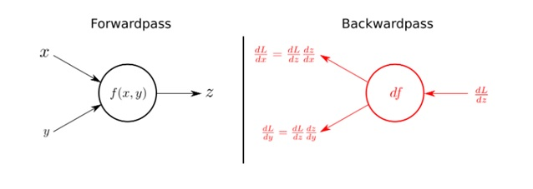
The overall steps are:
In the forward propagate stage, the data flows through the network to get the outputs
The loss function is used to calculate the total error
Then, we use backward propagation algorithm to calculate the gradient of the loss function with respect to each weight and bias
Finally, we use gradient descent to update the weights and biases at each layer
We repeat above steps to minimize the total error of the neural network.
Using the input variables x and y, the forward pass or propagation calculates output z as a function of x and y i.e. f(x,y).
During backward pass or propagation, on receiving dL/dz (the derivative of the total loss, L with respect to the output, z), we can calculate the individual gradients of x and y on the loss function by applying the chain rule, as shown in the figure.

